Slide 1

KST
29
CHESS
KST
29
NOVELS
CHESS
NOVELS
ML
EPE
ML
SD
ENG
EPE
SD
AI
BOOKS
DE
10
TM
DE
CONFIDENCE
ENG
TT
TT
RANDOM
PYTHON
2001
KST
BOOKS
TSAONGAF
TSAONGAF
10
PYTHON

Slide 2

KST
Python with Khaled Saje’
LEC 2

Slide 3

What we will learn in this LEC:
By Khaled Tayem
Print ()
Comments
Python variables
HW
KST

Slide 4

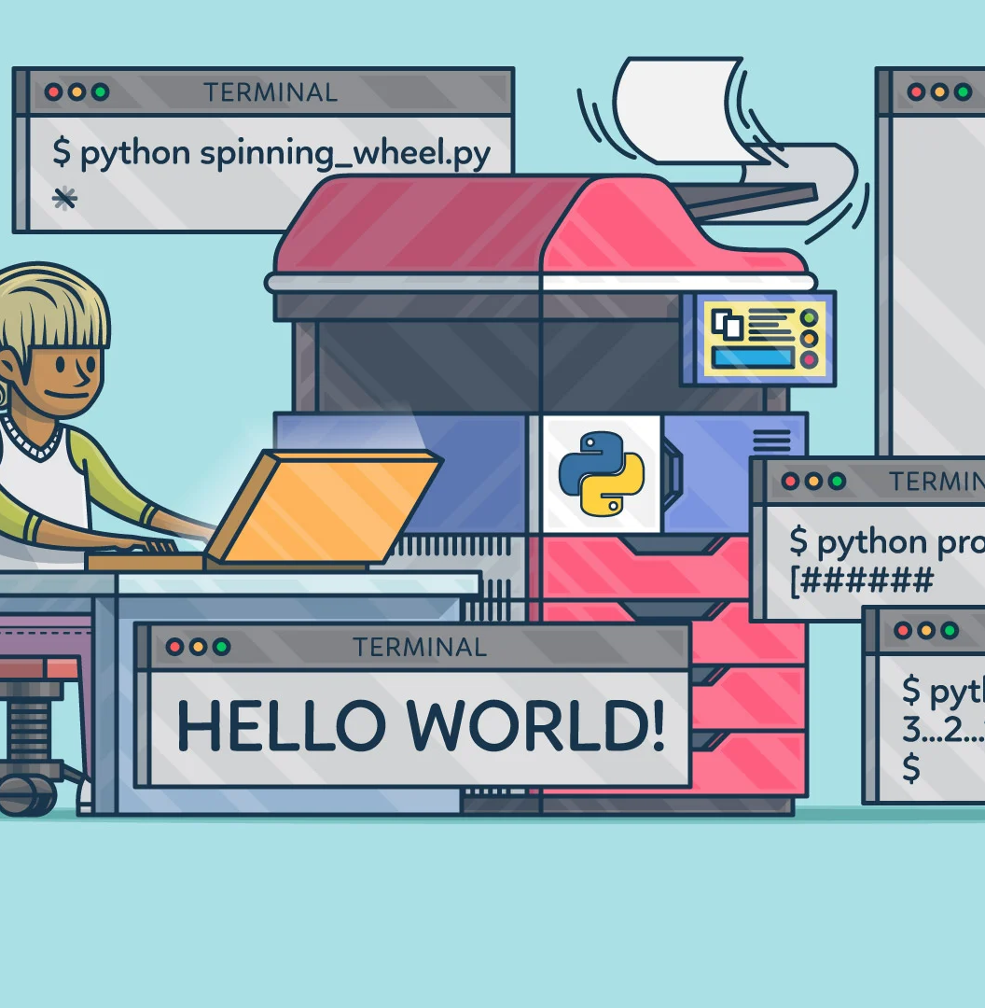
Print function in python
KST

Slide 5


Comments in python
KST

Slide 6


Python Variables
KST

Slide 7

KST
KST
Python HW
KST
KST

